Slide 1
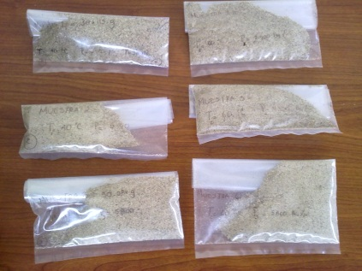
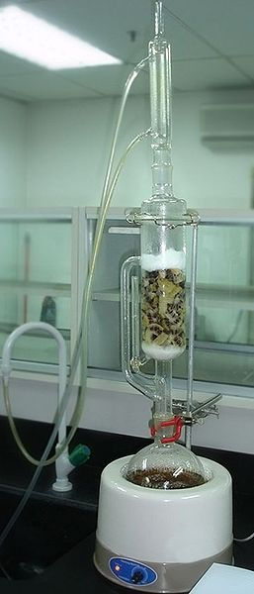
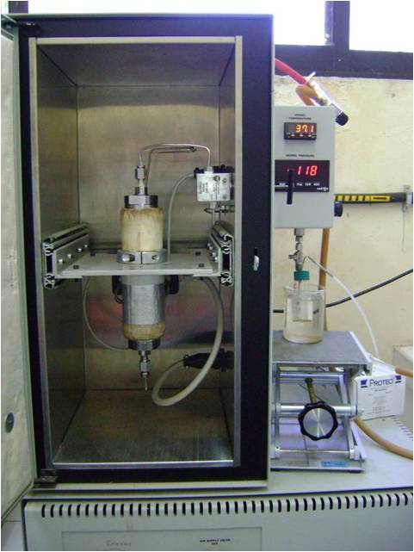
Extraction and characterization of oil from Moringa oleifera using supercritical CO₂ and traditional solvents Ortiz-Palafox J.^{1,} Díaz-de-la-Fuente J.M.^{1,} Figueroa-Coronel E. A.¹, Sacramento-Rivero J. C.¹, Rubio-Atoche C.¹, Acereto-Escoffie P.¹, Abelardo Navarrete ², Rocha-Uribe J.A.¹ 1: Facultad de Ingeniería Química, Universidad Autónoma de Yucatán, Periférico Nte Km 33.5, Colonia Chuburna de Hidalgo Inn. Merida, Yucatan; C. P. 97203; MEXICO; 2: LODEMO Group, Yucatan, Mexico Corresponding author: antonio.rocha@uady.mx; Phone (52-999) 946 0981 Ext: 1177
ABSTRACT
Looking for good raw material for biodiesel at the Mexican-Yucatan peninsula, the study present data on the extraction of oil from Moringa oleifera kernels. Solvent extraction with n-hexane and ethanol, and supercritical extraction with CO₂ are
presented and compared with reported data. For supercritical extraction pressures of 200 to 400 bar and temperatures of 40 and 60 ºC were tested. Analysis with Gas Chromatography reveals that the main fatty acids are Oleic acid (69 %), Palmitic acid (10 %), and stearic acid (8 %).
INTRODUCTION
Moringa oleifera is an Indian three that also grow in Asia, Africa, Southamerica, the Caribbean and Oceania.
The oil extracted from Moringa is known as Ben oil and contains approximately 70 % of oleic acid. It is a Fatty acid mono unsaturated that has good oxidative stability when compared with poly unsaturated fatty acids.
According with Abdulkarim et al [1] Ben oil is more stable tan canola oil, soybean oil, and palm oil when used in frying. Blending Ben oil with sunflower oil and soybean oil enhance the oxidative stability of the mixture. Mani et al [2] say that comparing its chemical properties, moringa seed oil is considered equivalent to olive oil, and may be used for edible purpose.
In Yucatan Mexico, Moringa seeds have been proposed as a good raw material. In this study we report experimental results from solvent soxhlet extraction using n-hexane and ethanol and supercritical extraction with CO₂. Solvent extraction have been reported by Mani et al [2] using n-hexane, petroleum ether and acetone, experimental Soxhlet extraction using n-hexane and ethanol, and supercritical extraction with CO₂ on moringa seeds have been reported by Nguyen et al [4]. Sovova and Stateva [5] in a recent article review the field of supercritical extraction of vegetable materials and say that industrial applications are increasing. It is hoped that the results will provide information to compare moringa seeds as raw material candidate for vegetable oil and biodiesel.
RESULTS
The results obtained for solvent extraction of Moringa oil are shown in Graphic 1. Data of Mani et al [2] is also presented.
The results of supercritical extraction are shown in Graphic 2. A kinetic run was done at the best conditions: P=400 bar and T=40 ºC. The result is shown in Graphic 3. Unfortunately the run was performed only a few hours and we did not measure the maximum yield.
Graphic 4. presents the content of the main fatty acids in the extracted oil measured by Gas Chromatography for solvent extraction and supercritical extraction using CO₂ and compares it with data of Nguyen et al [4]
.
METHODOLOGY
Separation of seeds from the membranes to reduce size
Extraction with solvents conventional
Static Extraction: 10 min
SFE -CO₂ conditions: 30 min of dynamic extraction: Pressures:200, 300 and 400 bar; temperatures 40 and 60 °C; CO₂ flow rate of 1.8 g/min
CONCLUSIONS
The extraction of oil from moringa seeds may be carried out by solvent extraction and supercritical extraction with CO₂. Additional economical and sustainable studies should be performed to select the optimal process.
Supercritical SFT-150 system
Kinetic run of 7 h: 40 °C, 400 bar, CO₂ flow rate of 1.8 g/min
REFERENCES
[1] Abdulkarim S. M., K. Long, O. M. Lai, S. K. S. Muhammad, H. M. Ghazali, Frying quality and stability of high-oleic Moringa oleifera seed oil in comparison with other vegetable oils, Food Chem. 105 (2007), 1382
[2] Mani, S.; Jaya, S. and Vadivambal, R. (2007). Optimization of solvent Extraction of Moringa (Moringa Oleifera) Seed Kernel Oil using response Surface Methodology. Food & Bioproducts Processing: Transactions of the Institution of Chemical Engineers Part C, Volume 85 Issue 4, pages 328
[3] Chuang, P.-H., Lee, C.-W., Chou, J.-Y., Murugan, M., Shieh, B.-J. and Chen, H.-M., 2007, Antifungal activity of crude extracts and essential oil of Moringa oleifera Lam., Bioresource Technology,
98: 232
[4] Nguyen, Hoang N.; Gaspillo, Pag-asa D; Maridable, Julius B.; Malaluan, Roberto M.; Hinode, Hirofumi.; Salim, Chris and Huynh, Ha K.P.(November 2011); Extraction of oil from Moringa oleifera kernels using supercritical carbon dioxide with ethanol for pretreatment: Optimization of the extraction process. Chemical Engineering & Processing. Volume 50, Issue 11/12, Pages 1207-1213.
[5] Sovová Helena and Stateva Roumiana P. (2011). Supercritical fluid extraction from vegetable materials. Reviews in Chemical Engineering, Volume 27, Issue: 3-4, Pages: 79-156.
[6] Damiani M. C., Popovich C. A., Constela D. Leonardi P. I., Lipid analysis in Haematococcus plavialis to assess its potential use as a biodiesel feedstock. 2010, Bioresource Technology, 101, 3801
Characterization the main fatty acids

